Slide 1


SAP S/4HANA CDS, BTP Full Stack Training Day 5
Anubhav Oberoy

Slide 2

Day 4
CDS Table Function
--break
CDS BOPF Integration
BOPF Scenario
Use case
Setting up BAS tool
Fiori Display App
--Draft
Validation
Determination
Action
Draft Capabilities
Notes:
https://unsplash.com/photos/CPs2X8JYmS8

Slide 3

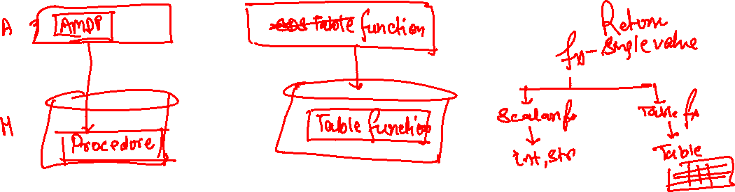
CDS Table Function
There are following additional features and support needed in CDS
CDS Views do a strict type check when we do associations and joins because of that we have certain limitations in CDS Views
If we want to integrate AMDP with CDS
If we want to use HANA native features with CDS
Complex logic we want to be implemented using CDS (SQL Script)
CDS Table functions are just like AMDP. An AMDP generates a procedure in HANA but a CDS Table function creates a table function (UDF) in HANA.
A table function definition defines the structure of output table
The definition must be activated first before we create Sql script logic in amdp class
www.anubhavtrainings.com

Slide 4





















Slide 5
CDS-BOPF Integration
Can I update data using CDS views also.
Anubhav SAPGUI have locking concept while data updates, can we also do it while building app from Fiori
What is BOPF, my manager asked me to learn CDS and BOPF for next project
What is Fiori programming model for S/4HANA
How can we overcome disadvantages of GUI applications?
Why did SAP choose still ABAP as middleware for S/4HANA Solution?
fiori
Scaling of app due to session stickiness
Bad user experience
Device switch (draft)
Collaboration
Performance
Support of oData
Adapt SAP Fiori
Device switch (draft)
Collaboration
Performance
pre
odata
app
app
100GB
100GB
Investments done by partners and customers
BAPIs, LUWs
Reports, Includes,
Programs, Classes
Workflows, Scripts, SF
SPRO, Webdypro
BOPF – since 2009 in SAP, Business Object processing framework
db
hana
www.anubhavtrainings.com

Slide 6

BOPF
Stands for Business Object processing framework, which generates most of application code to create, update, delete, lock, unlock, modify, patch data based on a business object (data model).
Now we can create
CDS views with association
Code
Business Object (fuel)
BOPF
www.anubhavtrainings.com

Slide 7
Scenario
We are working in an airline company inside S/4HANA project. They have a challenge due to pandemic to deliver the meal to departing flights from airport. The supervisor along with flight crew has to plan the meal which will be on-boarded in the flight.
The staff would use a tablet most of time to check status of on-going flights and number of seats in that flight.
We want to develop solution which can help us creating new flight entry
Change meal assignment of a particular flight
Also take approval from food manager for the assigned meal
@EndUserText.label : 'Flight Meals'
@AbapCatalog.enhancement.category : #NOT_CLASSIFIED
@AbapCatalog.tableCategory : #TRANSPARENT
@AbapCatalog.deliveryClass : #A
@AbapCatalog.dataMaintenance : #ALLOWED
define table zoft_meals {
key mandt : mandt not null;
key meal_id : /bobf/uuid not null;
carrid : s_carr_id;
connid : s_conn_id;
meal : s_mealnum;
total_seats : s_seatsmax;
status : flag;
}
SO
SO_I
www.anubhavtrainings.com

Slide 8


















Slide 9















Slide 10
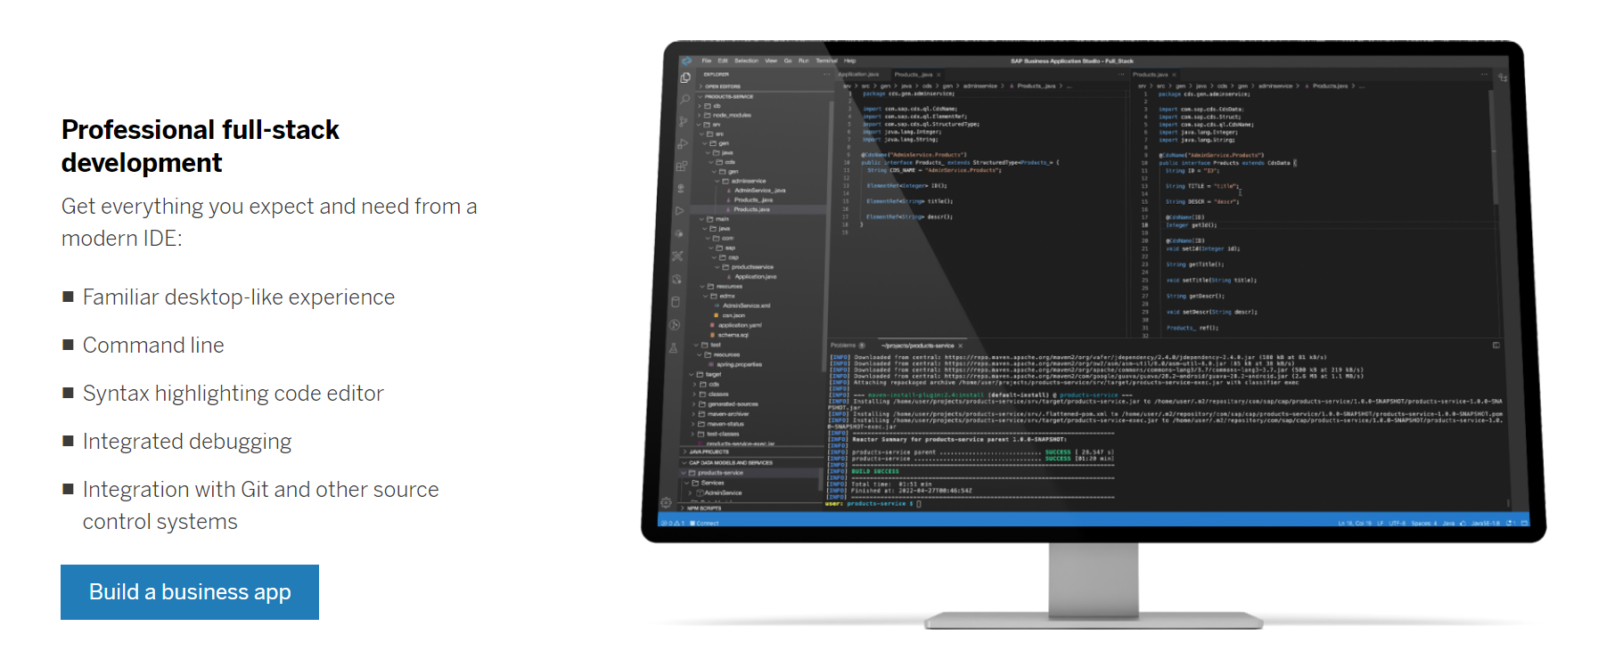
Business Application Studio
SAP Business Application Studio is a development environment available on SAP Business Technology Platform. It is a cloud-based professional developer tool for building applications and extending SAP solutions. The integrated development environment (IDE) in the cloud supports full-stack scenarios to speed development and innovation. Development spaces, virtual environments equipped with the runtimes and tools required for specific development scenarios, are at the heart of SAP Business Application Studio.
www.anubhavtrainings.com

Slide 11
Title
Fiori UI
OData
BOPF
class
HANADB
https://www.youtube.com/watch?v=C9MWowuCxis&list=PLcxqFaocb9WLtnq-rpXbRy5hnKECxr95G&index=88
www.anubhavtrainings.com

Slide 12

Questions?

Slide 13


Thank you
Anubhav.abap@gmail.com
contact@anubhavtrainings.com
+91 84484 54549
www.anubhavtrainings.com

